Slide 1
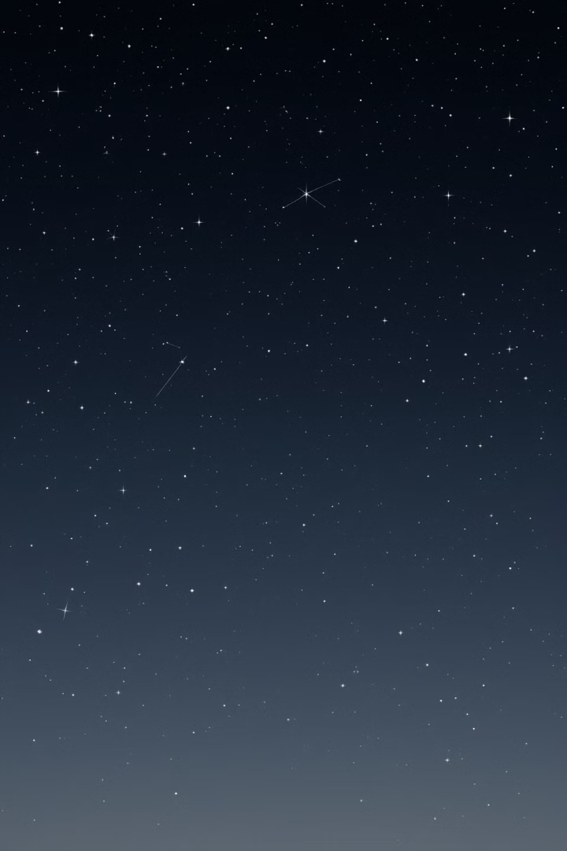

Exploring the Universe: An Introduction to Astronomy
Astronomy is a journey of discovery, taking us from the familiar night sky to the vast expanse of the cosmos. It's a science that has captivated humanity for millennia, driven by our innate curiosity about the universe and our place within it. Join us as we delve into the fundamental concepts, captivating phenomena, and groundbreaking discoveries that make astronomy both fascinating and essential.
by Rahul Jamgade

Slide 2
Astronomy: A Journey Through the Cosmos
The Universe: Our Cosmic Neighborhood
A Science of Exploration and Discovery
Astronomy delves into the vast universe, from the fiery births of stars to the enigmatic dance of galaxies. It seeks to understand the origins, evolution, and fundamental laws governing this awe-inspiring realm. From the familiar planets in our solar system to distant galaxies, astronomy unveils the secrets of the cosmos, revealing its beauty and complexity.
Astronomy is a science of relentless exploration, driven by the human spirit of curiosity. It's fueled by our desire to push the boundaries of knowledge, unraveling cosmic mysteries and expanding our understanding of the universe. Whether through powerful telescopes or theoretical models, astronomers strive to unveil the universe's hidden wonders.

Slide 3
Unlocking the Universe's Secrets: The Branches of Astronomy
Observational Astronomy
Theoretical Astronomy
Observational astronomy involves collecting data about celestial objects using telescopes and various instruments. From visible light to radio waves, astronomers study the electromagnetic spectrum, deciphering the universe's signals and revealing the properties of celestial objects.
Theoretical astronomy uses mathematical models and simulations to understand the behavior and evolution of cosmic phenomena. This branch bridges the gap between observation and theory, providing a deeper understanding of the universe's workings.

Slide 4
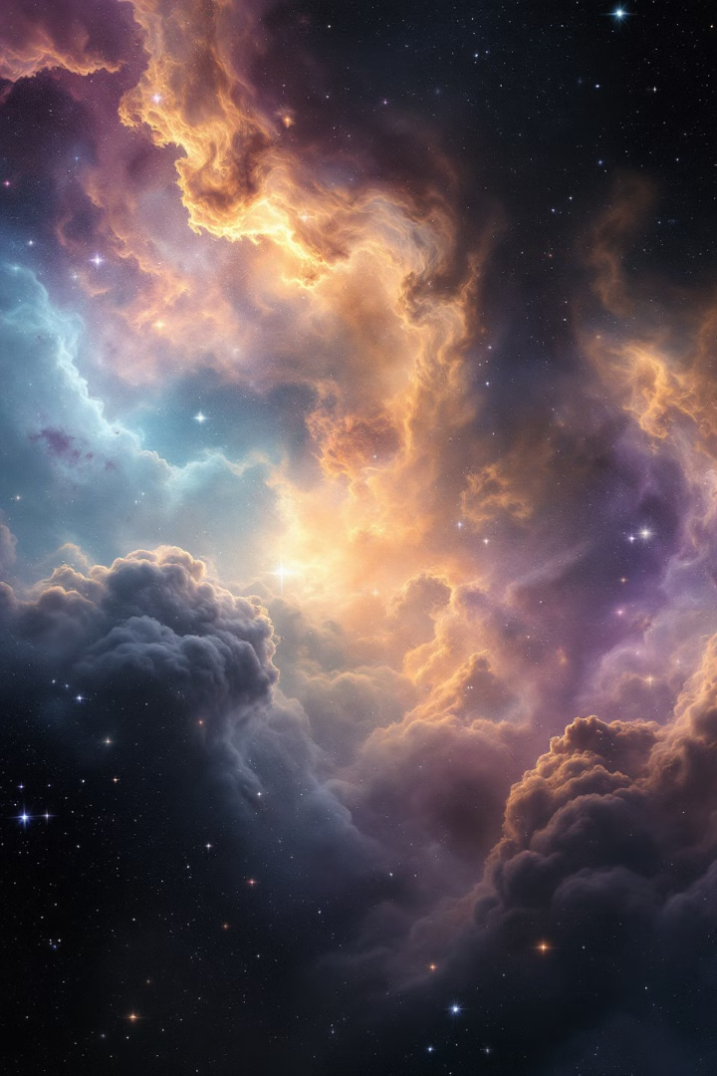
The Universe: A Vast and Dynamic Realm
Our universe is a vast and ever-changing entity, estimated to be 13.8 billion years old. It's teeming with billions of galaxies, each containing millions of stars. Its origin lies in the Big Bang, a monumental event that marked the birth of space and time. The universe continues to expand, a testament to the ongoing cosmic dance, revealing its dynamic nature.

Slide 5





Our Cosmic Home: The Solar System
Sun
1
The center of our solar system, a star that provides warmth and light.
Inner Planets
2
Rocky and terrestrial worlds, including Mercury, Venus, Earth, and Mars.
Outer Planets
3
Gas giants and ice giants, including Jupiter, Saturn, Uranus, and Neptune.
Asteroids and Comets
4
Rocky remnants and icy bodies, remnants of the solar system's formation.
Kuiper Belt and Oort Cloud
5
Regions beyond Neptune, containing icy bodies and comets.

Slide 6
The Sun: Our Life-Giving Star
Structure
Energy Generation
Solar Activity
The Sun has a layered structure, including the core where nuclear fusion occurs, the photosphere where visible light is emitted, and the corona, the outer atmosphere.
The Sun generates energy through nuclear fusion, converting hydrogen into helium. This process releases immense energy, powering life on Earth.
The Sun undergoes an 11-year cycle of activity, with variations in solar flares, sunspots, and coronal mass ejections, influencing space weather.

Slide 7
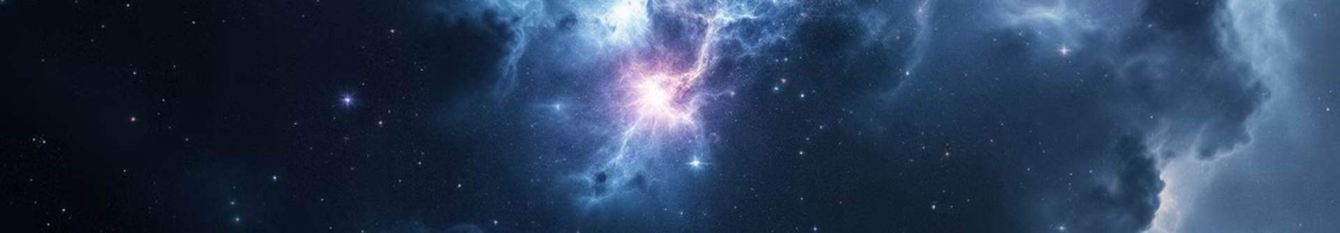
Stars: Celestial Factories of Light
1
2
3
4
Birth
Main Sequence
Red Giant
End States
Stars are born in nebulae, vast clouds of gas and dust. Gravity pulls these materials together, leading to the formation of a protostar.
Stars spend most of their lives on the main sequence, a stable phase where hydrogen fuses into helium in their cores.
As stars exhaust their hydrogen fuel, they expand and become red giants, cooler and larger than their main sequence stage.
Stars end their lives in various ways, depending on their mass. Low-mass stars become white dwarfs, while high-mass stars undergo supernovae.

Slide 8
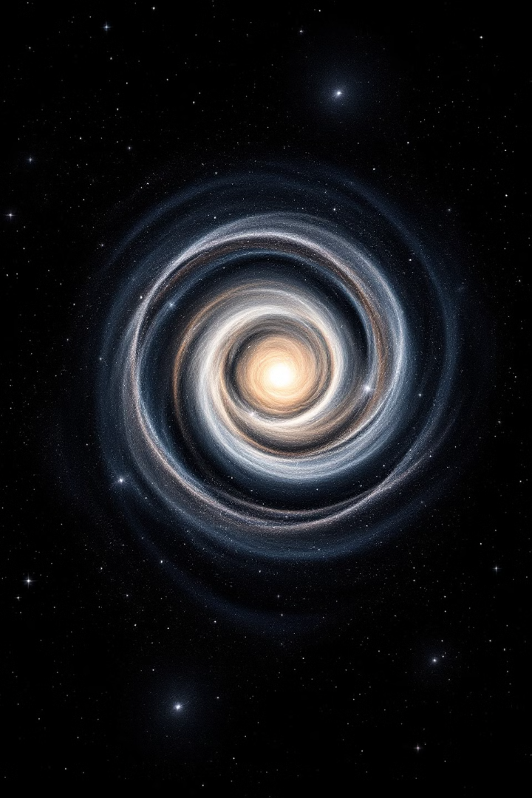
Galaxies: Islands of Stars
Spiral Galaxies
Elliptical Galaxies
These galaxies, like our Milky Way, have a central bulge and spiral arms, containing actively forming stars.
Elliptical galaxies are older and less active, with a smooth, oval shape and predominantly older stars.
Irregular Galaxies
Irregular galaxies lack a defined shape, often resulting from galactic collisions, with a chaotic distribution of stars and gas.

Slide 9
Our Home Galaxy: The Milky Way
Structure
Size
Center
The Milky Way is a barred spiral galaxy, with a central bar and spiral arms, containing over 100 billion stars. Our Solar System is located in the Orion Arm.
It spans approximately 100,000 light-years in diameter, showcasing its vastness and the immense distances between stars.
A supermassive black hole, known as Sagittarius A*, lies at the center of the Milky Way, influencing the galaxy's dynamics.

Slide 10
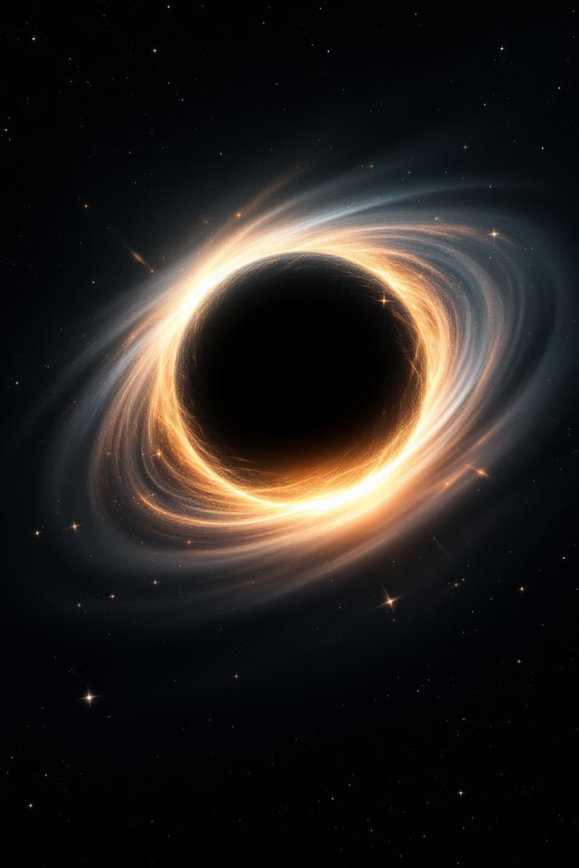
Black Holes: Cosmic Enigmas
1
Formation
2
Event Horizon
Black holes form from the collapse of massive stars at the end of their lives, where gravity overwhelms all other forces.
Black holes have an event horizon, a point of no return where even light cannot escape their intense gravity.
3
Singularity
4
Types
At the center of a black hole lies a singularity, a point of infinite density where the laws of physics as we know them break down.
Black holes come in various sizes: stellar-mass black holes, a few times the Sun's mass, and supermassive black holes found at the centers of galaxies.

Slide 11




Worlds Beyond Our Solar System: Exoplanets
Transit Method
Radial Velocity Method
This method detects exoplanets by observing the slight dimming of a star as a planet passes in front of it.
This method detects exoplanets by observing the slight wobble in a star's motion caused by a planet's gravitational pull.
Direct Imaging
This method directly captures images of exoplanets, although it's challenging due to the faintness of the planets compared to their host stars.

Slide 12
Our Celestial Companion: The Moon
Formation
1
The Moon is thought to have formed from a collision between Earth and a Mars-sized object, with the debris coalescing to form our satellite.
Tides
2
The Moon's gravity exerts a significant pull on Earth's oceans, causing tides to rise and fall.
Phases
3
The Moon's phases result from its orbit around Earth, as we see different amounts of its sunlit side.
Atmosphere
4
The Moon lacks a substantial atmosphere, leading to extreme temperature variations between day and night.

Slide 13
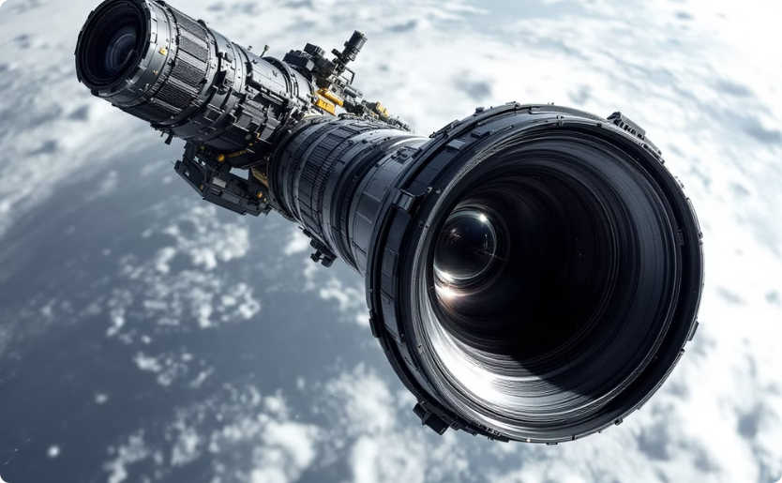
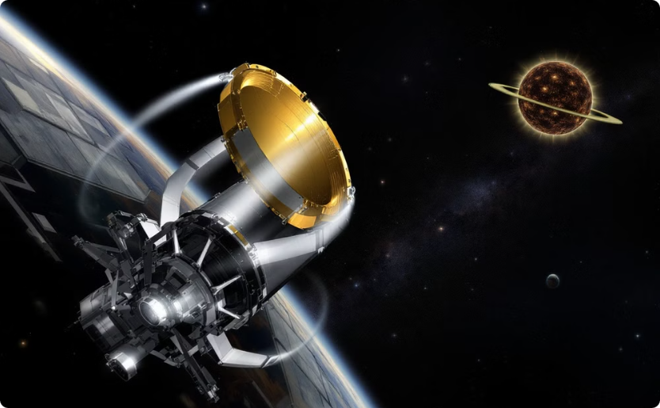
Peering into the Universe: Space Telescopes
Hubble Space Telescope
James Webb Space Telescope
Launched in 1990, Hubble has revolutionized astronomy, providing stunning images and insights into deep space.
Launched in 2021, Webb is poised to study the early universe, exoplanets, and other cosmic phenomena.

Slide 14
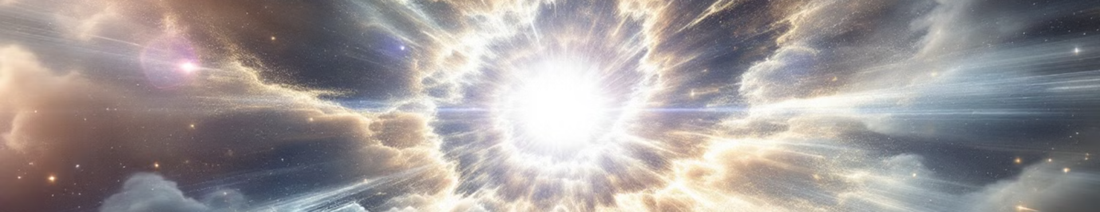
Supernovae: Stellar Explosions
Type Ia Supernovae
Type II Supernovae
These occur when a white dwarf star accretes matter from a companion star, exceeding a critical mass and exploding.
These occur when a massive star exhausts its nuclear fuel, its core collapses, and the star explodes.

Slide 15

Echoes of the Big Bang: The Cosmic Microwave Background
The Cosmic Microwave Background (CMB) is a faint glow of radiation that permeates the entire universe, providing evidence for the Big Bang theory. Discovered in 1964, it represents the leftover radiation from the universe's initial hot and dense state.

Slide 16
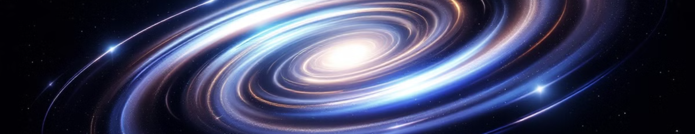
Unveiling the Invisible: Dark Matter
Dark matter, an enigmatic substance that makes up approximately 27% of the universe, does not interact with light, making it invisible. Its existence is inferred through its gravitational influence on galaxies and other cosmic structures.

Slide 17
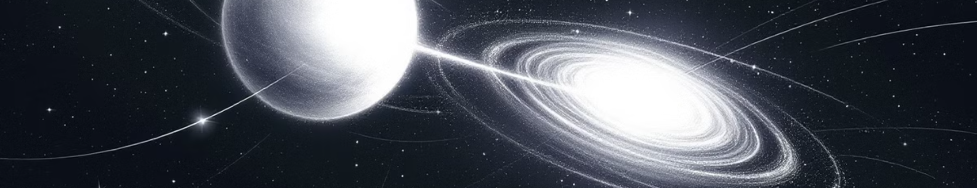
The Expanding Universe: Dark Energy
Dark energy is a mysterious force driving the accelerated expansion of the universe, accounting for about 68% of its total energy density. Its nature and origin remain a major mystery, with ongoing research attempting to unravel its secrets.

Slide 18

Searching for Life Beyond Earth: Astrobiology
Astrobiology is the study of the potential for life beyond Earth, exploring the conditions necessary for life to arise and evolve. It examines extremophiles on Earth, which thrive in extreme environments, providing clues for life's potential elsewhere.

Slide 19
Cosmic Visitors: Comets and Asteroids
Comets
Asteroids
Comets are icy bodies that develop tails when they approach the Sun, vaporizing their ice and creating a luminous trail.
Asteroids are rocky remnants from the early solar system, often found in the asteroid belt between Mars and Jupiter.

Slide 20
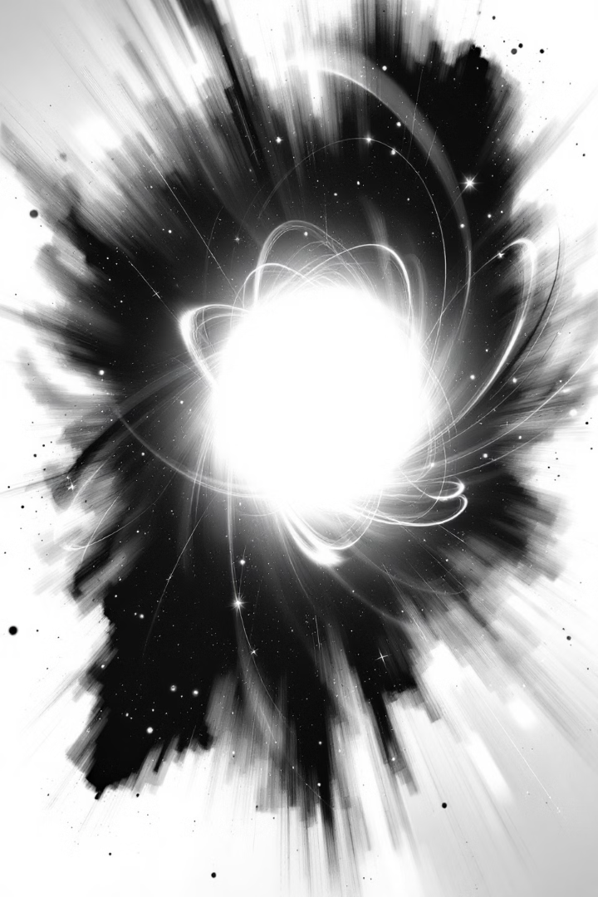
Neutron Stars: Stellar Remnants
Neutron stars are incredibly dense objects formed from the collapse of massive stars during supernovae. They are composed of tightly packed neutrons and are often characterized as pulsars, emitting powerful radio waves due to their rapid rotation.

Slide 21

The Multiverse Hypothesis: Beyond Our Universe
The multiverse hypothesis proposes the existence of multiple universes, each potentially with different physical laws and constants. It's supported by concepts from quantum mechanics and string theory, suggesting a vast and unimaginably complex cosmic landscape.

Slide 22
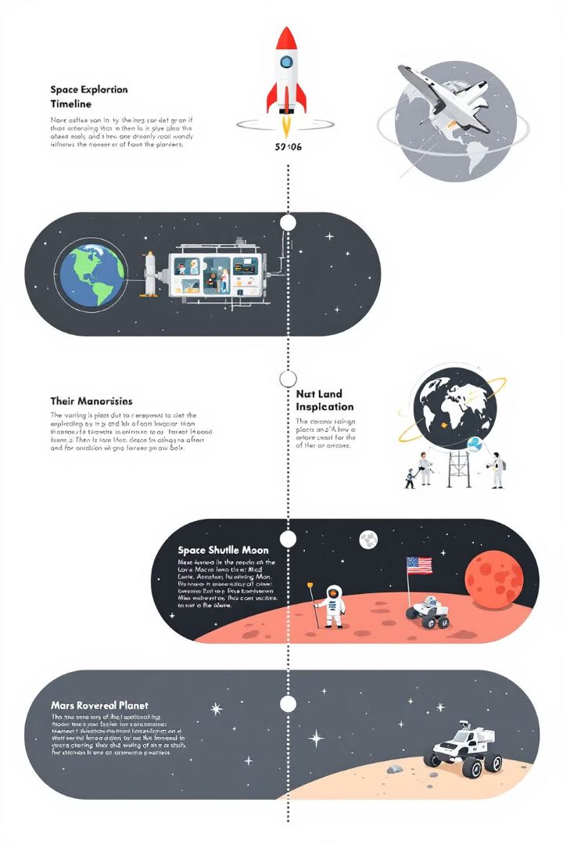
A Journey of Exploration: Space Exploration Milestones
1
1957
Sputnik, the first artificial satellite, is launched by the Soviet Union, marking the beginning of the space race.
2
1969
The Apollo 11 mission lands the first humans on the Moon, a monumental achievement in human history.
3
2021
The James Webb Space Telescope is launched, heralding a new era of astronomical exploration.

Slide 23
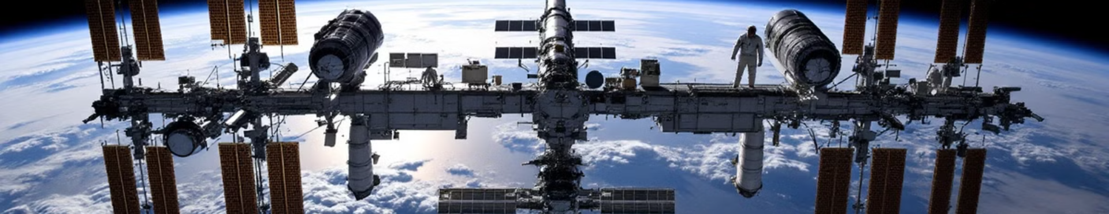
A Global Collaboration: The International Space Station (ISS)
The International Space Station (ISS) is a collaborative project involving multiple countries, orbiting Earth at an altitude of about 400 km. It serves as a unique platform for conducting scientific experiments in microgravity and advancing our understanding of space.

Slide 24
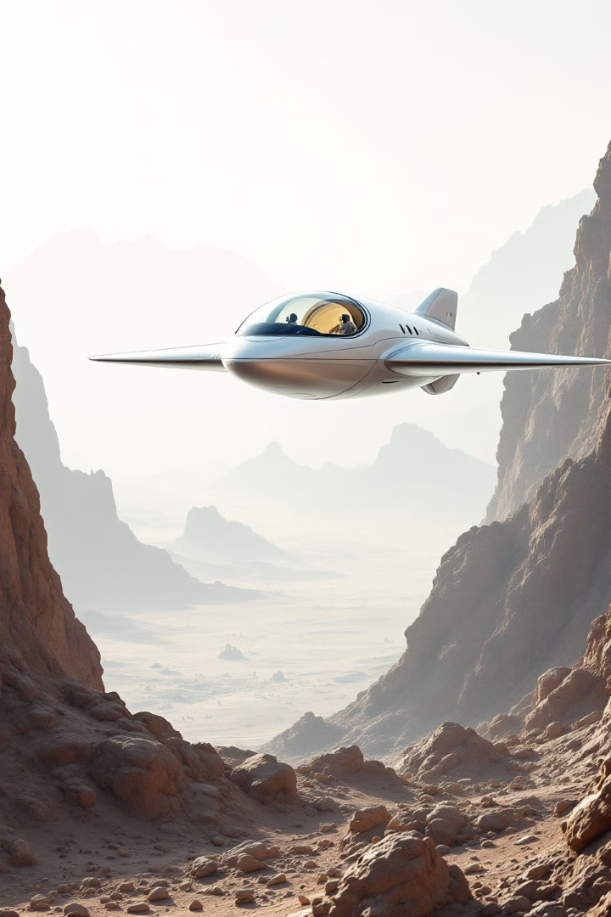
The Fermi Paradox: Where Are They?
The Fermi Paradox explores the apparent contradiction between the high probability of extraterrestrial civilizations and the lack of any confirmed evidence for their existence. It raises questions about the nature of life and intelligence in the universe.

Slide 25

Astronomy: A Window to the Cosmos
Astronomy offers a unique perspective on our place in the universe. From amateur stargazing to professional research, we can all contribute to our understanding of the cosmos. Whether exploring the night sky with a telescope or engaging with online resources, astronomy invites us to delve into the wonders of the universe.

